Slide 1
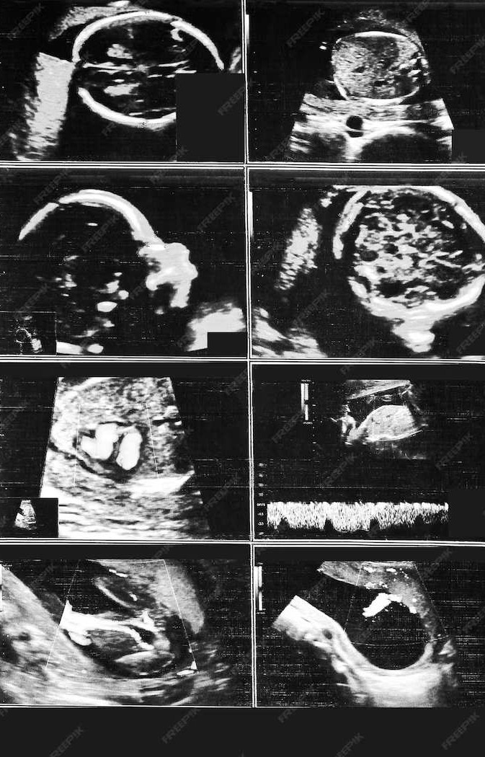
Fetal Ultrasound Image Analysis
Rithika Gadapa EC21B1067
Anudeep Yelakala EC21B1071
M Devi Akshitha EC21B1100

Slide 2
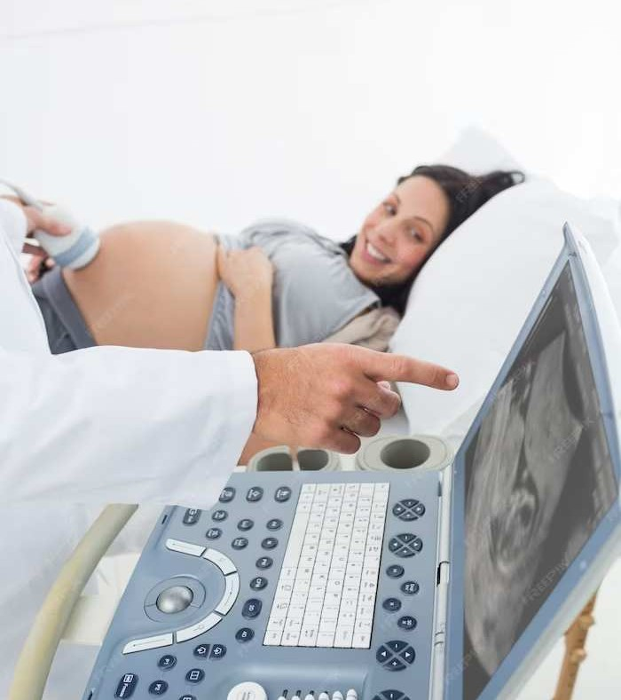
Introduction
The project embarked on an ambitious journey to revolutionize fetal health diagnostics by focusing on the automated detection and analysis of the Nuchal Translucency (NT) and nasal bone structures in 11-12 week old fetuses. Employing advanced machine learning techniques, specifically deep learning models, the project aimed at providing accurate, non-invasive methods for early detection of chromosomal abnormalities such as Down syndrome. Utilizing a dataset of ultrasound images, the project's crux was to develop a robust model capable of precisely identifying and marking the NT and nasal bone features. This innovative approach not only promised to enhance the efficiency and accuracy of early fetal screenings but also aimed to support clinicians in making informed decisions, thus ensuring better prenatal care and management.

Slide 3
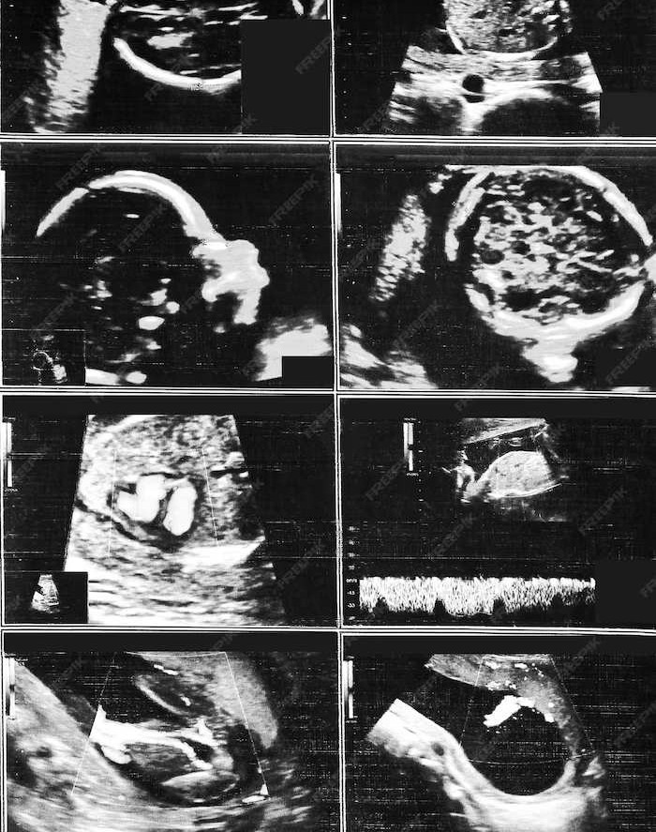
Hypothesis
The core of this project was anchored on training a convolutional neural network (CNN) using TensorFlow and Keras, leveraging the powerful VGG16 architecture. The model underwent meticulous training and validation processes, involving the careful annotation of thousands of ultrasound images to mark the NT and nasal bone structures accurately. This extensive training enabled the model to learn and predict with high precision, ensuring reliability in clinical applications. The project's outcome not only holds the potential to be a game-changer in early fetal diagnostics but also stands as a testament to the incredible capabilities of AI in transforming healthcare.

Slide 4
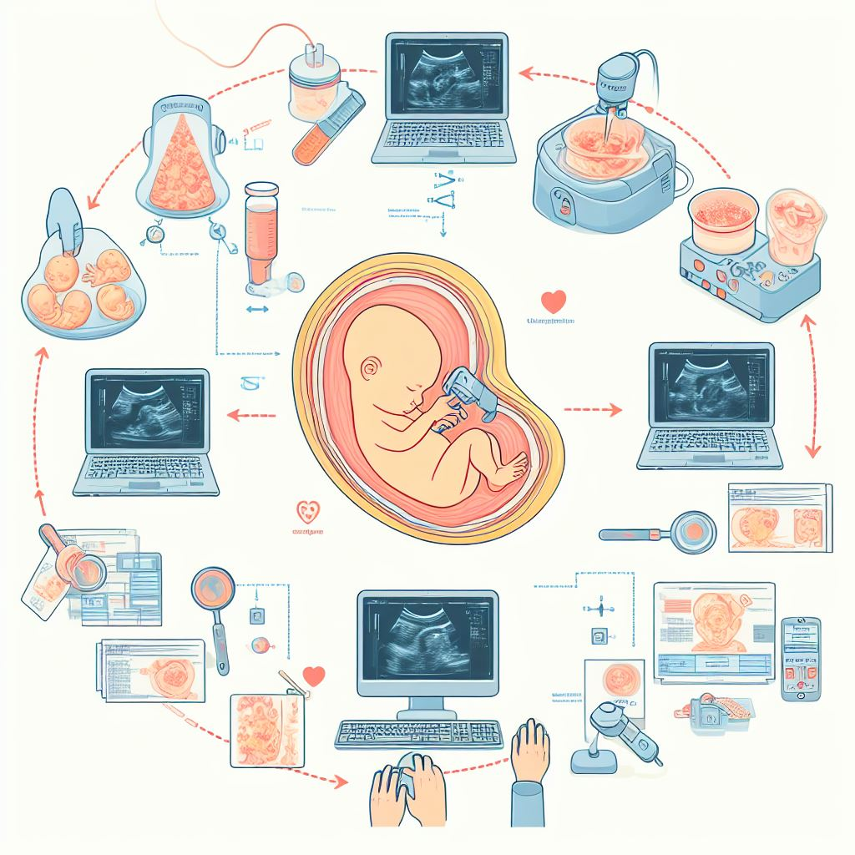
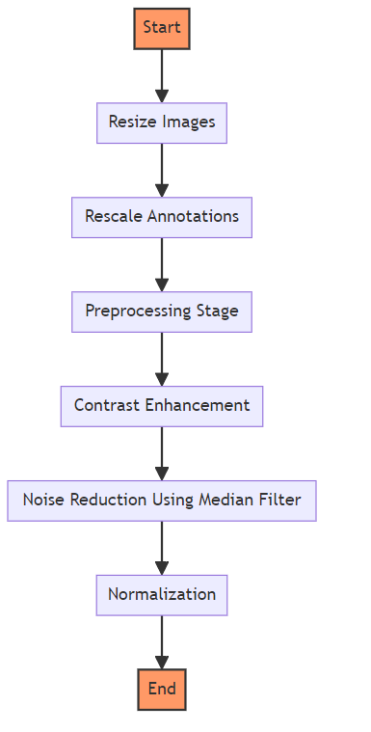
Preprocessing Flowchart

Slide 5
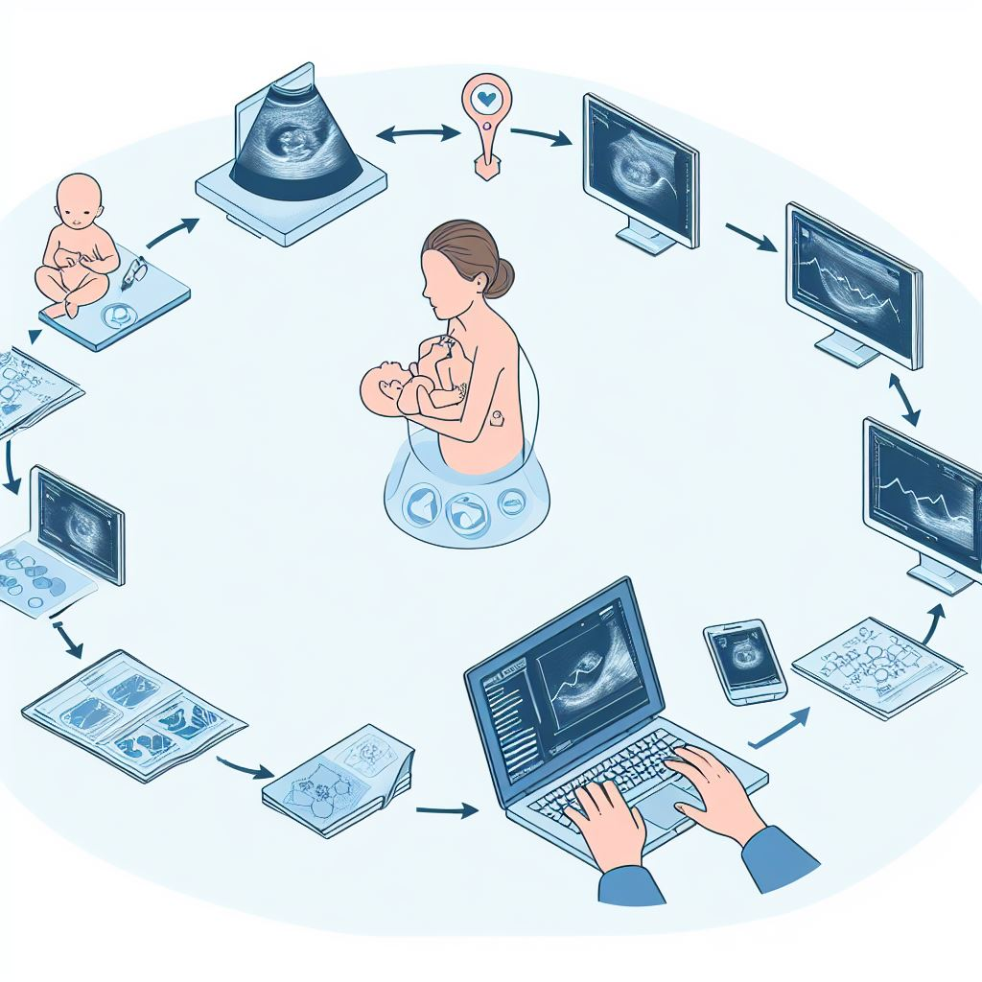
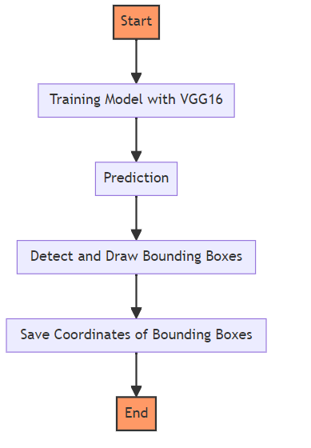
Modelling Flowchart

Slide 6
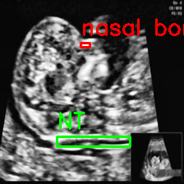
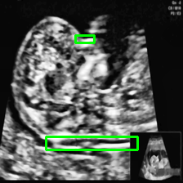
Original Annotated image
Model Prediction

Slide 7
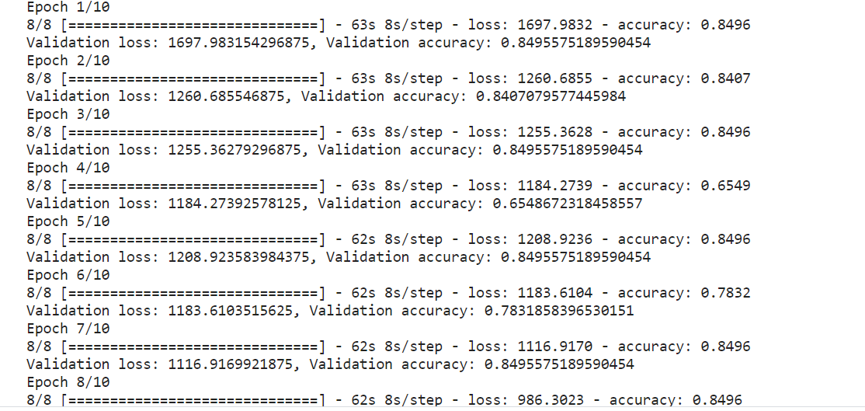
Accuracy check

Slide 8
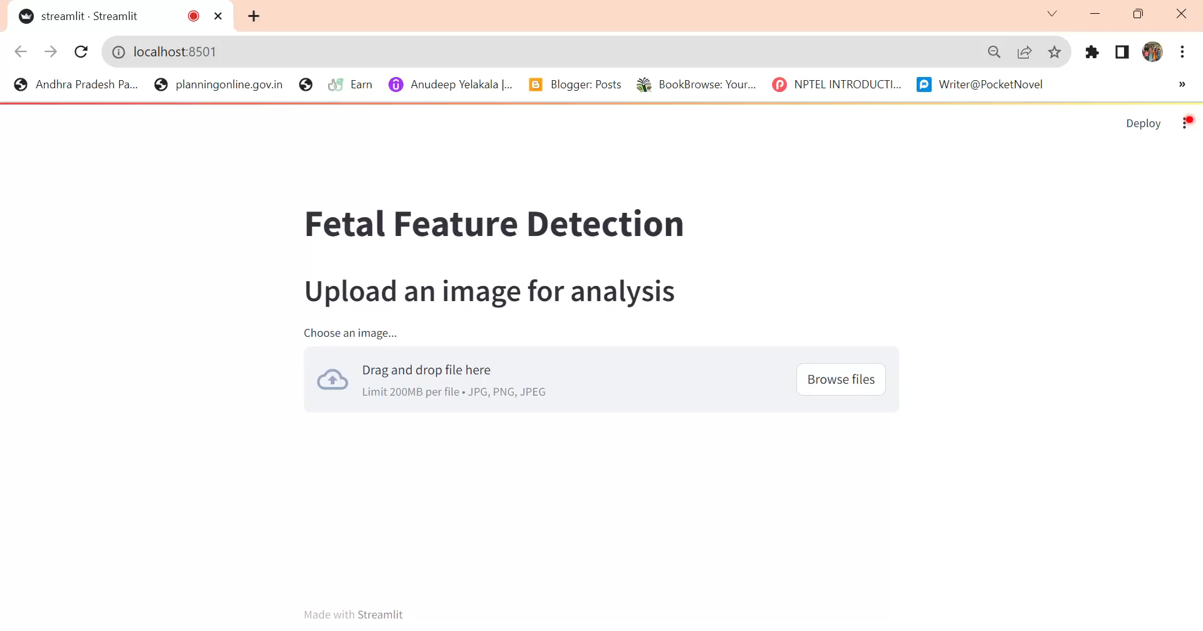

Slide 9

Links
Drive link

Slide 10
Conclusion
In conclusion, the advancements in fetal ultrasound image analysis are reshaping prenatal care and clinical decision- making. Embracing these advancements will lead to improved patient outcomes and further advancements in the ﬁeld.

